Slide 1



Facilitating Student Support: Suicide Risk Assessment and Re-Entry Meeting Training
Support Services Mental Health Program
David Richey, Executive Director, Support Services
Michele DeJournett, Assistant Director, Support Services
Olivia Dahlin, Mental Health Program Coordinator, Support Services

Slide 2


Slide 3

*Take a moment to reflect on
why you joined SAUSD
*Why did you choose the role you are currently in?
*What is the impact you want to have on the students and families we serve?
*Use this image to the right to help create a WHY statement.

Slide 4

SAUSD Board Policy
“Suicide Prevention Training and Education to be provided to all school staff members who interact with students. Training shall be designed to help staff members identify and respond to students at-risk of suicide. This includes staff development on risk factors, warning signs, protective factors, response procedures with emphasis on immediately (same day) referring a student, referrals, and school and community resources regarding suicide prevention and mental health.”

Slide 5

Learning Objectives
Overview of Youth Suicide
To help recognize warning signs and risk factors affecting student’s mental health
To increase understanding of the District’s Suicide Risk Assessment Protocol and Forms
To respond and intervene appropriately to support students who present with suicidal ideation and self-harming behaviors
To increase understanding of the District’s Mental Health Re-entry Meeting Protocol and Forms

Slide 6

What is suicide?
One of the leading causes of death
Serious public health problem (exacerbated by Covid)
Far reaching impact (family, community, society)
Can be prevented!

Slide 7
Youth Suicide Facts
Each day in our nation, more than 5,000 students in grades 7-12 attempt suicide.
SUICIDE is the 2nd leading cause of death for youth aged 10-24; boys & girls; across all ethnicities.
1 in 6 youth in the U.S. aged 6-17 experience a mental health disorder each year.
50% of all lifetime mental illness begins by age 14, and 75% by age 24.

Slide 8
Important definitions related to
Suicide Awareness
Suicide is defined as death caused by self-directed injurious behavior with intent to die as a result of the behavior.
A suicide attempt is a non-fatal, self-directed, potentially injurious behavior with intent to die as a result of the behavior. A suicide attempt might not result in injury.
Suicidal ideation refers to thinking about, considering, or planning suicide.
Self-injurious behavior is the occurrence of behavior that results in intentional physical injury to one's own body

Slide 9
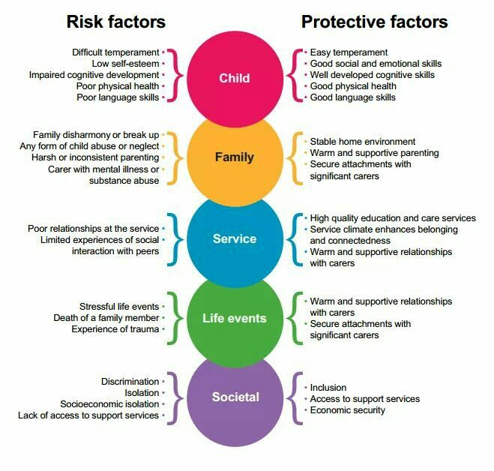
Risk Factors & Protective Factors

Slide 10
Elementary: Warning Signs of Suicide
Withdrawal, crying spells, becoming less verbal, lack of interest in familiar activities
Efforts to hurt self
Threats to run impulsively into traffic or danger
Jumping from high places or threats to jump, such as getting up in a tree, climbing on a fence
Writing or drawing suicidal themes
Sudden changes in behavior often indicates stressful times or that something impactful has recently occurred

Slide 11
Adolescents: Warning Signs of Suicide
Suicide notes -May write a note on Gaggle or social media (ex. Facebook, Instagram)
Threats- Can be direct (ex. I want to kill myself; I could just die) or indirect (“The world/family would be a better place without me”)
Plan/Means/Intent/Access -The greater the detail in the plan, the greater the risk
Depression- Depression is a risk factor for suicide, but also hopelessness, helplessness, no sense of belonging and feeling like a burden to others
Reckless Behavior- can also be more subtle such as not eating, purposely crossing the street without looking, disregarding safety precautions (“whatever happens happens” thinking)
Atypical Behavior- sudden grade drops, mood changes, change in attendance

Slide 12
Avoiding activities that expose the body (i.e. arms, elbows, thighs)
Physical signs of self-harm on the body (i.e. scratches, cuts, burns, scars)
Dressing inappropriately for the weather (i.e. long sleeves/hoodies in summer)
Hiding potentially dangerous items/objects (i.e. sharpeners, razor blades, scissors)
Recent self-injuries should be evaluated by school nurse
Warning signs of self-injurious behavior

Slide 13
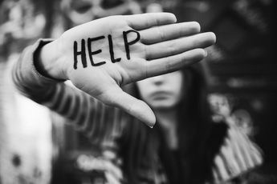
Signs that require IMMEDIATE attention
The student expresses
suicidal feelings.
“I wish I were dead.”
“I am going to end it all.”
“You will be better off without me.”
“What is the point of living?”
“Soon you won’t have to worry about me.”

Slide 14

Supporting your student during disclosure of
Suicide Ideation
DO
DON’T
Ask Direct Questions
Ensure student supervision by certificated staff at ALL TIMES!
Conduct a risk assessment the same day!
Consult with your Team
X Don’t be afraid to go there
X Don’t wait until the end of the day or the next day to tell a School Administrator/Supervisor
X Don’t let the student leave campus without a safety assessment being completed.

Slide 15
What do I say?
“I appreciate that you trusted me to tell me this. Now, I want to get you help.”
“I can only imagine how scared you might feel.”
“No one should have to be in this much pain, let’s get you help.”
“I am so sorry that you have had to suffer, please know there is help.”
“I am honored that you felt you could come to me. Now we can get you the help you need so you don’t continue hurting like this.”
Erbacher et al (2015)

Slide 16
What not to say (avoid knee-jerk reaction to fix)
“I understand what you are going through.”
“You should think of the positive.”
“Your parents would be mad to hear you say these things.”
“Consider all that you have to live for.”
“I’ll be right back.”
Erbacher et al (2015)

Slide 17
True or false?
Asking students about suicide puts the idea or thought in their head. It is best not to bring it up so they do not engage in the behavior.
True
False

Slide 18
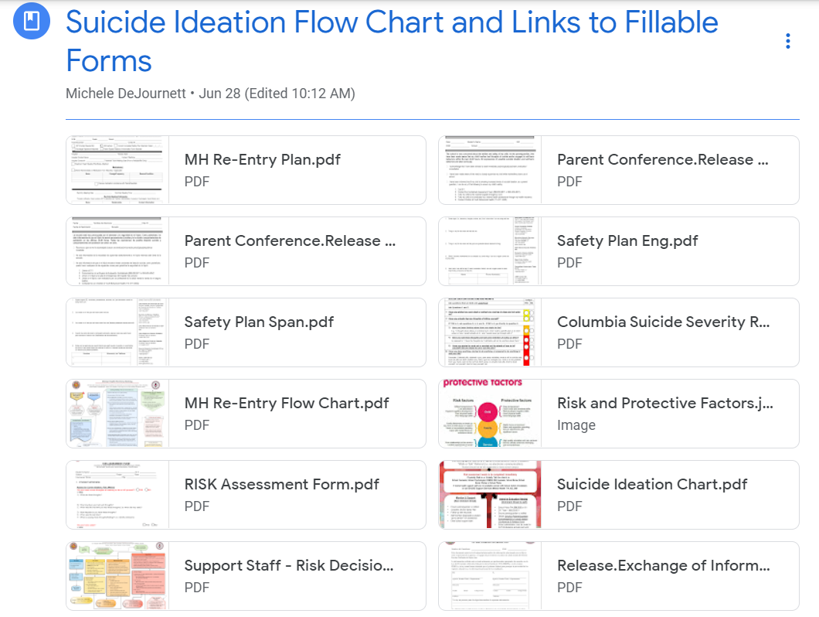
Accessing SAUSD Risk Assessment & Re-Entry Forms
Google Drive
Click on ‘Classroom’ icon
‘Join class’ by clicking on + top right corner
Enter Class code: m5sljpc to enter Support Services platform
Click on ‘Classwork’ and scroll down to Mental Health Menu on the left column
Scroll down to “Suicide Ideation Flow Chart and Links to Fillable Forms”

Slide 19
SAUSD Protocol for Suicidal Ideation and Support
When warning signs are observed, conduct a “Walk and Talk Referral” for support for the student.
Risk Assessment needs to be completed immediately/ same day.

Slide 20

During a crisis, please refer to the district’s protocol and utilize your school’s first line of defense which includes:
School counselors
School psychologists
School nurses
ERMHS therapists
DIS counselors
School Police/School Resource Officers
Please keep in mind, our social workers will serve as a crisis support referral only after the school has utilized their internal team for Suicide Risk Assessment. In these cases, please contact Support Services at 714.433.3481.

Slide 21
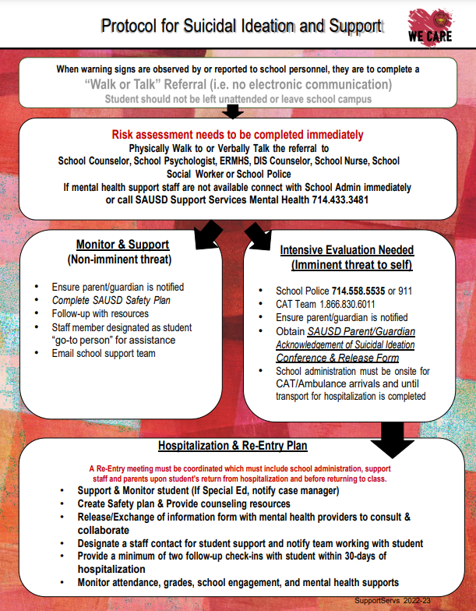
SAUSD Suicide Ideation Protocol

Slide 22
Risk Assessment Forms
Risk Assessment form
Columbia Scale
Safety Plan

Slide 23
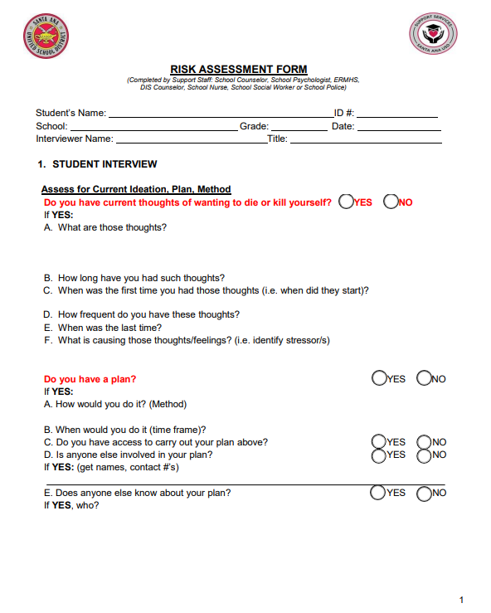
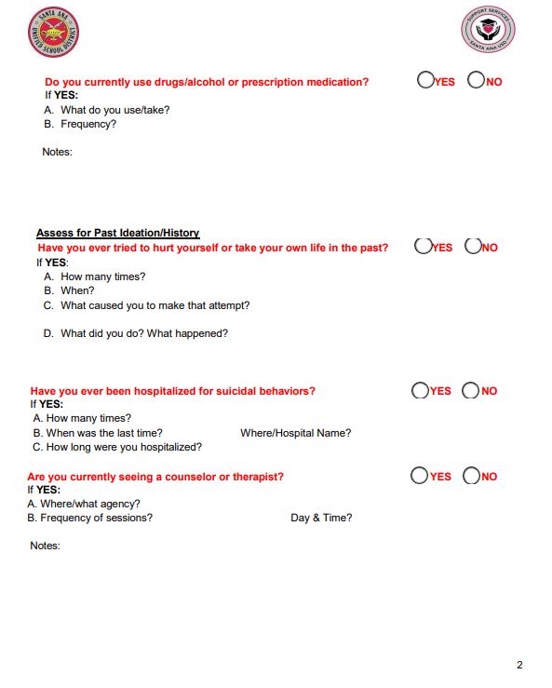

Slide 24
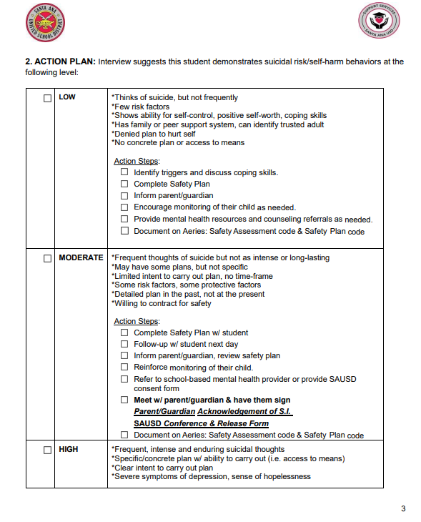
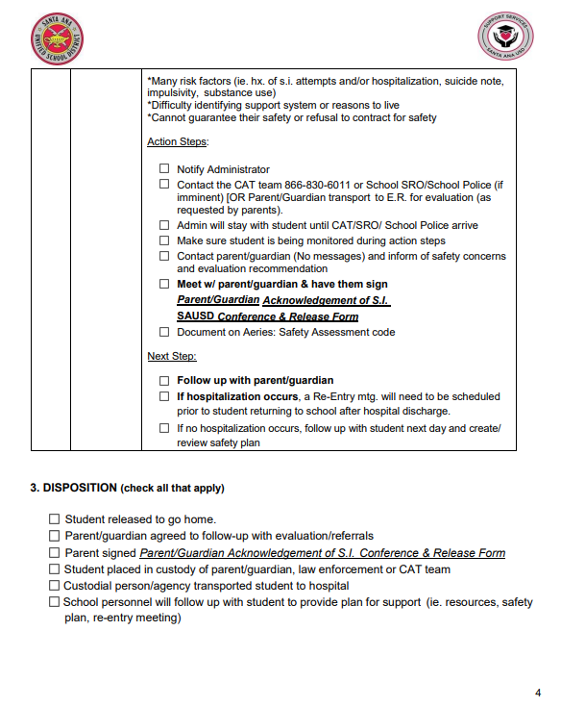

Slide 25
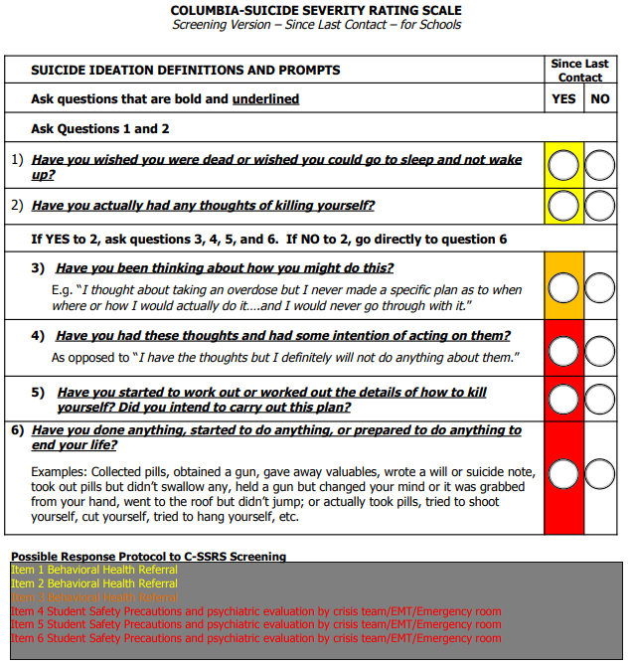

Slide 26
SAUSD Risk Assessment Decision Tree
Form designed to assist with the student interview to determine the level of risk assessment and identify necessary interventions and support.
SAUSD Risk Assessment Decision Tree (next slide)

Slide 27
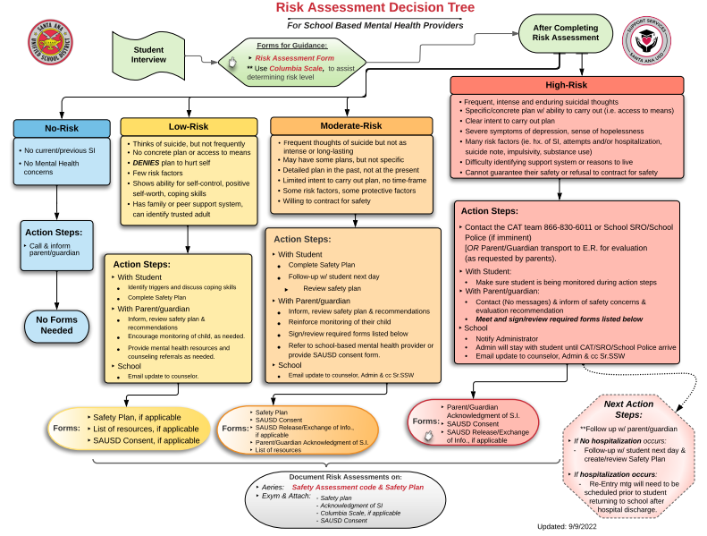

Slide 28
Safety Planning
A Safety Plan is created with students who are at-risk of suicide ideation and/or self-harming behaviors.
The purpose is to help the student identify their:
1) Warning Signs 2) Triggers 3) Protective factors/reasons for living 4) Coping skills 5) Safe people and 6) Emergency Resources
It is not a “no suicide” contract.
Collaborative approach between you and the student. Take your time!
Original given to student. Make a copy & review safety plan with parent/caregiver.
Notify staff members that were identified in student’s safety plan.
Second page includes grounding and relaxation techniques.
Provided in English and Spanish on Google Classroom.
Sample on next slide.

Slide 29
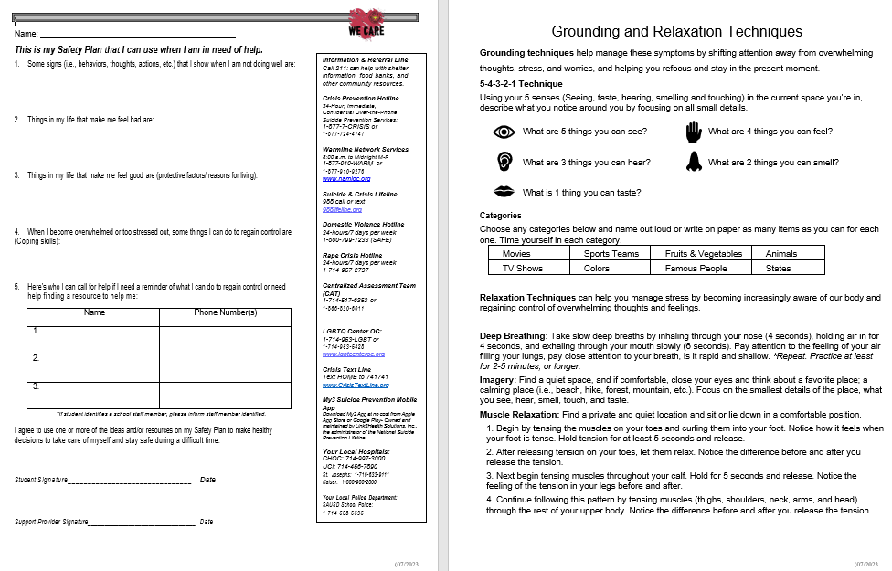
Student
Safety Plan
Found in Google
Classroom in
English and
Spanish

Slide 30
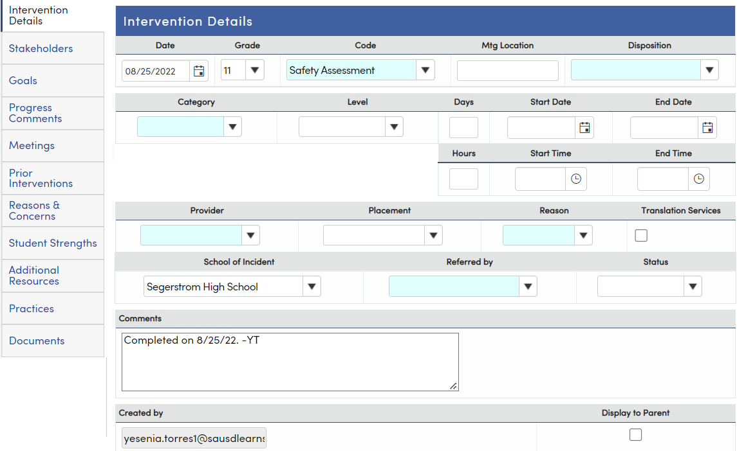
Aeries
“Risk Assessment” and “Safety Plan” Interventions code
**Under comments, please do not include detailed information.
Aeries Note Example: “Completed on __/__/__”
Uncheck box that says “Display to Parent”

Slide 31

Parent/Caregiver Acknowledgement
of Suicidal Ideation
Main Purpose: to inform and have parent/caregiver acknowledge that they have been notified about the current safety concerns (suicide ideation or self-harm)
Signed form is required for moderate or high risk
Form needs to be discussed/reviewed/signed on the same day.

Slide 32
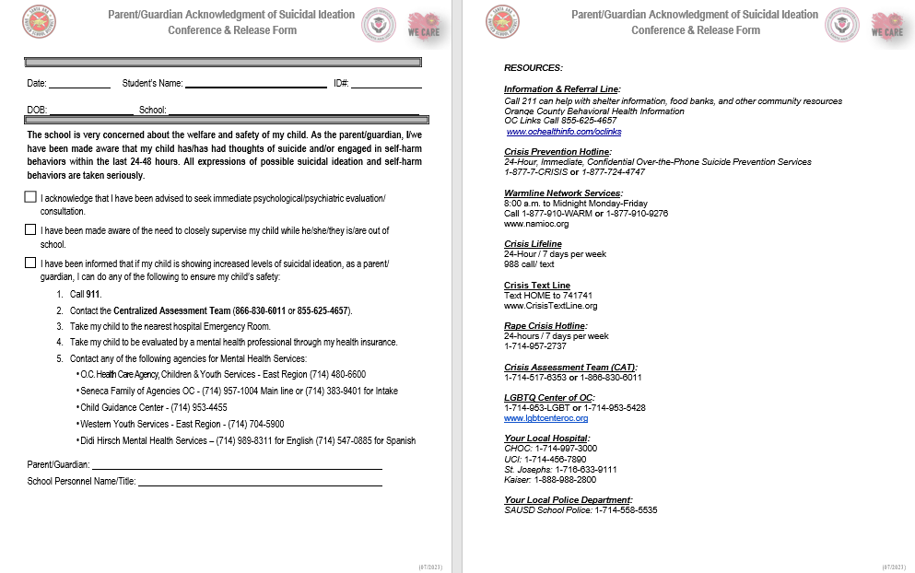
Parent/Guardian Acknowledgement Form
Found in Google
Classroom in
English and
Spanish

Slide 33
Who Can Evaluate for Hospitalization?
Centralized Assessment Team (CAT)
School Resource Officer (SRO)
School Police

Slide 34
Helpful Considerations When Calling CAT
Make sure student is not left alone when calling CAT (866-830-6011)
Share specific safety concerns reported by student (i.e. thoughts, plan, means, intent, access, prior hospitalizations, prior attempts)
CAT will ask that parent/caretaker be notified & be asked to come to the school
Print out Aeries student demographics prior to evaluator coming out

Slide 35

Centralized Assessment Team (CAT)
Evaluation Process
Contact with Team Member who requested evaluation/did initial risk assessment
Parent Interview
Student Interview
Plan of Support:
  Linkage to community resources: (In-Home Crisis, Be Well,
  Community Counseling clinic)
  Recommendation for hospitalization (72 hr. Hold or longer)

Slide 36
IMPORTANT!
*Any risk assessments documents must be kept separate from student’s cumulative file in order to protect student’s private/personal information.

Slide 37
Mental Health Re-Entry Meetings
Purpose: to address issues of mental health, attendance, behavior, medication (if needed) and academics.
It includes creating a plan to address the above issues as well as any other concerns of the student/family and to address follow-up services and interventions.
A MH Re-entry meeting should be held prior to the student’s return and should include the student, parent/caregiver, administrator and support staff (i.e., school counselor, psychologist, ERMHS, DIS counselors, school nurse, school social worker, etc.).
Erbacher et al (2015)

Slide 38
Coordinating the Re-Entry Meeting
The treating hospital may reach out to point person (i.e., support staff) to provide hospitalization update and potential discharge date.
Contact should be made with parent/caregiver to confirm discharge date and to educate them on need for re-entry meeting
Set meeting date & time w/ student/parent/school personnel
Ask parent/caregiver to bring hospital discharge paperwork
Please reference MH Re-entry Meeting Flowchart
A Safety Plan needs to be completed w/ student after the Re-Entry mtg. (same day). A copy should be kept by the school.

Slide 39
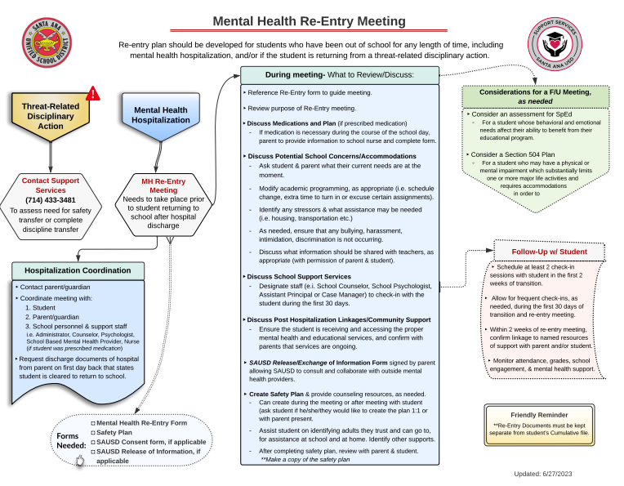
Found in Google
Classroom

Slide 40
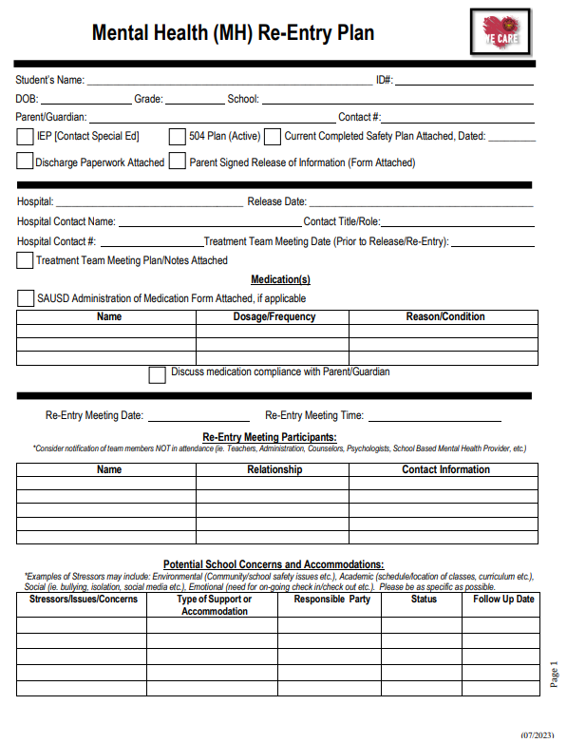
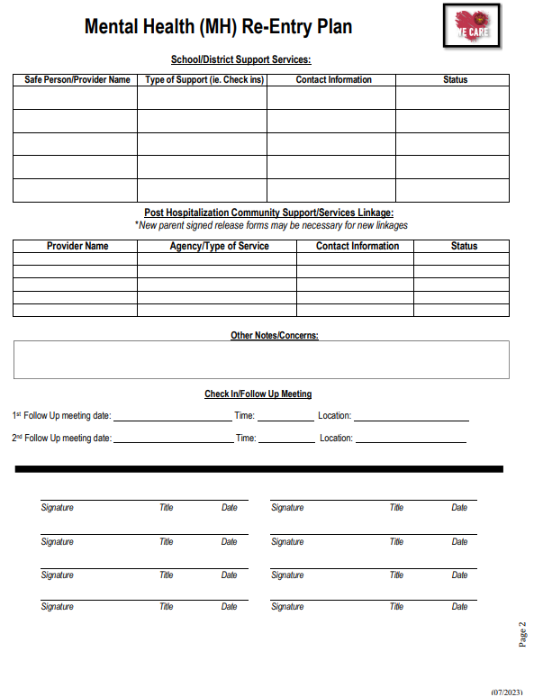
Mental Health Re-entry Form
Found in Google
Classroom

Slide 41
IMPORTANT!
*Any Re-entry documents must be kept separate from student’s cumulative file in order to protect student’s private/personal information.
Notes:
Student and parent/caregiver input should be obtained throughout meeting
Only the minimum necessary information should be shared/explored (i.e., all of the details of the hospitalization should not be discussed)
Internal and external supports should be reviewed and coordinated
Who will be assigned to follow-up with student more regularly until next follow-up meeting is scheduled? How often will that student be check-in on? (i.e., weekly, bi-weekly, etc.)

Slide 42
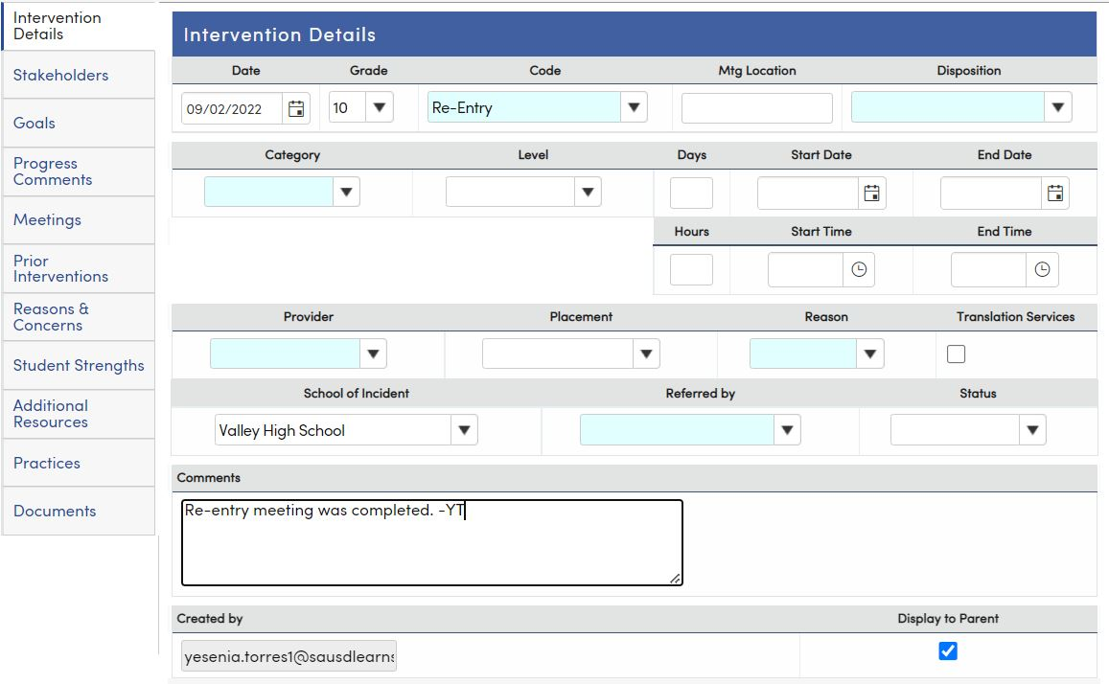
Aeries
“Re-Entry” and “Safety Plan” Interventions code
**Under comments, please do not include detailed information about the meeting.
Aeries Note Example: “Completed on __/__/__”
Uncheck box that says “Display to Parent”

Slide 43
Student care for post-hospitalization
Student will require check-ins at school during the first month.
Student will likely have been linked by the hospital to a Mental Health agency in the community or to a MH provider via the family’s health insurance. If this is the case, MH treatment will not be provided by a SAUSD SSW, however, a SSW can help with case management.

Slide 44
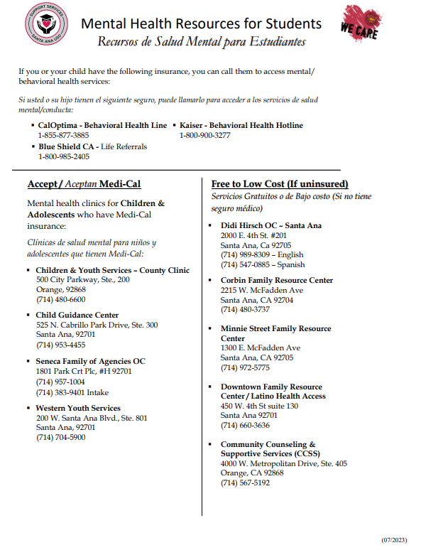
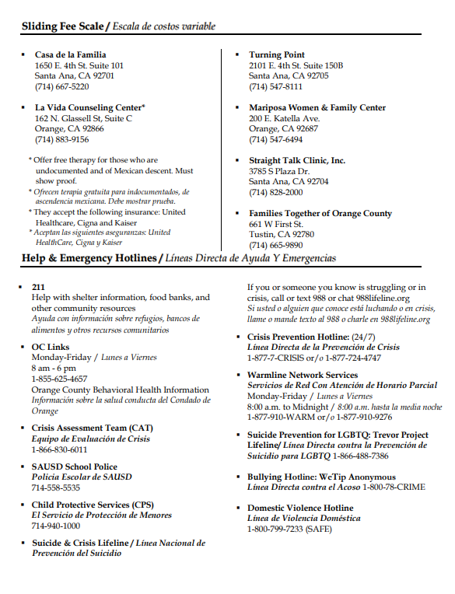
MH Resources
Found in Google
Classroom for students and adults

Slide 45

Please reach out to your regional Senior School Social Worker with specific questions. If you don’t know who to call, please reach out to Support Services, Mental Health Program, for assistance at 714-433-3481. Thank you!

